Slide 1
CARDIOVASCULAR DISEASE ANALYSIS
PRESENTED BY
SUNITHA MEKALA

Slide 2
Introduction:
Cardiovascular disease (CVD) is a class of diseases that involve the heart or blood vessels. Cardiovascular diseases are the leading cause of death globally. This is true in all areas of the world except Africa. Together CVD resulted in 17.9 million deaths (32.1%) in 2015. Deaths, at a given age, from CVD are more common and have been increasing in much of the developing world, while rates have declined in most of the developed world since the 1970s.
I have conducted Exploratory Data Analysis (EDA) of the Cardiovascular disease dataset. As, the primary objective of EDA is to analyze the data for distribution, outliers and anomalies in the dataset. It enable us to direct specific testing of the hypothesis.

Slide 3

Required Libraries:

Slide 4
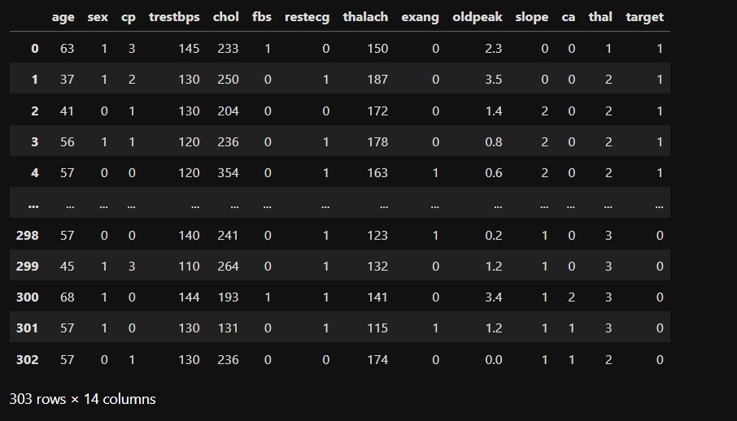
Dataset:
Collected the data set of Cardiovascular disease and I have conducted Exploratory Data Analysis (EDA) of this dataset.
Its stored in the csv file named -> heart.csv

Slide 5
Data Understanding:
Data understanding process includes collecting and exploring the data.
The data we have collect consist of 303 instances with 14 attributes.
The attributes are:
age -- Age
sex -- (1-male, 0-female)
cp – Chest Pain
trestbps – Resting blood pressure (in mm Hg on admission to the hospital
chol – Serum Cholestrol

Slide 6
Data Understanding:
fbs -- Fasting blood sugar
restecg -- Resting Electrocardiagraphic results
thalach -- Maximum heart rate achieved
exang – Exercise induced angina
oldpeak – ST depression induced by exercise relative to rest
slope – The slope of the peak exercise ST segment
ca – Number of major vessels (0-3) colored by flourosopy
thal – Thalassemia
Target – 1 or 0

Slide 7
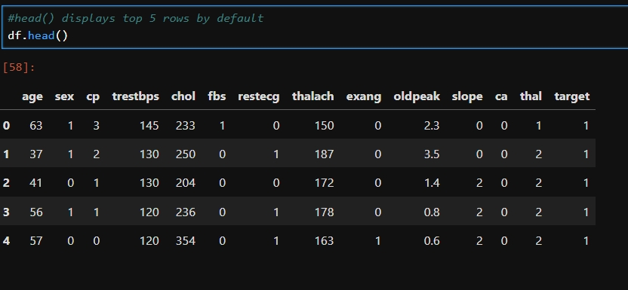
Displays top 5 rows of the Dataset:

Slide 8
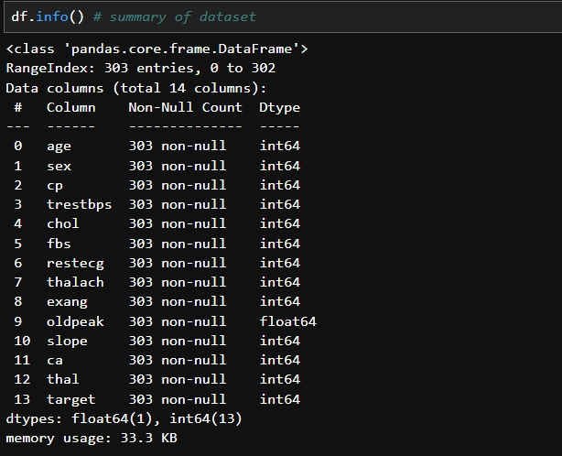
Data pre-processing
This shows the summary of DataFrame, offering a quick and informative overview of the dataset.
Gives Information about our Dataset like Total Number Rows, Total Number of Columns, Datatypes of Each Column and Memory Requirement

Slide 9
Checking the data type:
sex is a character variable. Its data type should be object. But it is encoded as (1 = male; 0 = female). So, its data type is given as int64.
Same is the case with several other variables - fbs, exang and target.- fbs (fasting blood sugar) should be a character variable as it contains only 0 and 1 as values (1 = true; 0 = false). As it contains only 0 and 1 as values, so its data type is given as int64.
exang (exercise induced angina) should also be a character variable as it contains only 0 and 1 as values (1 = yes; 0 = no). It also contains only 0 and 1 as values, so its data type is given as int64.
target should also be a character variable. But, it also contains 0 and 1 as values. So, its data type is given as int64.

Slide 10
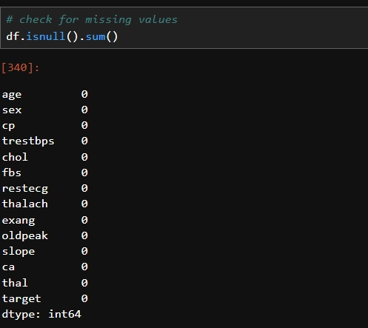
Analyzing null values:
We can see that there are no missing values in the dataset.

Slide 11
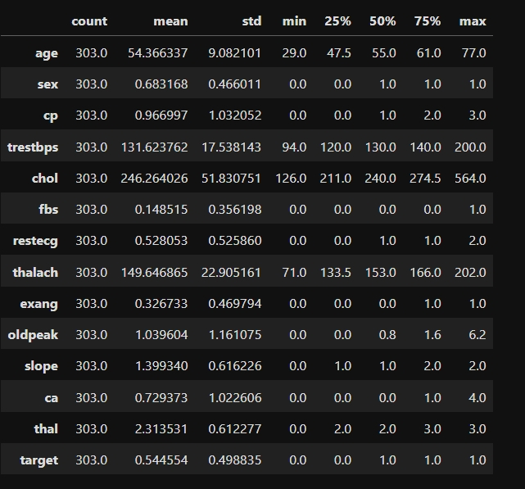
Understanding data using Descriptive Statistics:
Gives Statistical properties of Dataset
Visual description

Slide 12
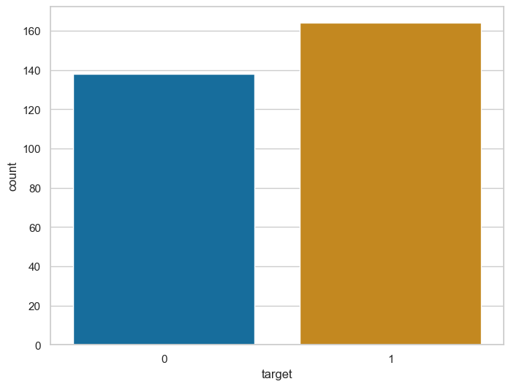
Univariate Analysis:
Findings of Univariate Analysis of target feature variable:
Our feature variable of interest is target.
It refers to the presence of heart disease in the patient.
It is integer valued as it contains two integers 0 and 1 - (0 stands for absence of heart disease and 1 for presence of heart disease).
- So, in this section, let’s visualize and interpret frequency distribution of ‘target’ variable.
This plot confirms the below findings:
There are 165 patients suffering from heart disease and
There are 138 patients who do not have any heart disease.

Slide 13
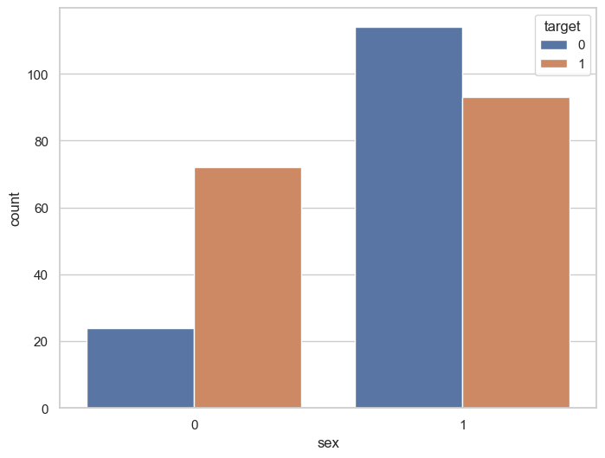
Visualizing the value counts of the ‘sex’ attribute towards ‘target’ attribute:
‘sex’ variable values 1 and 0 : (1 = male; 0 = female)
‘target’ variable values 1 and 0 : (1 = Presence of heart disease; 0 = Absence of heart disease)
According to the plots, Out of 96 females - 72 have heart disease and 24 do not have heart disease.
Similarly, out of 207 males - 93 have heart disease and 114 do not have heart disease.

Slide 14
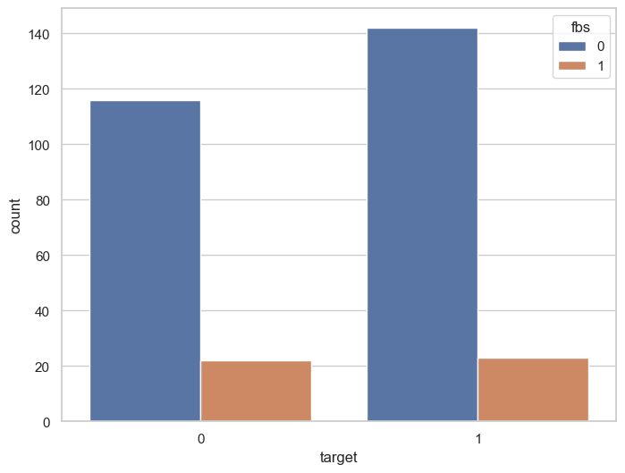
Showing Fasting Blood Sugar(fbs) variable distribution according to target variable:
fbs : (fasting blood sugar > 120 mg/dl) (1 = true; 0 = false)target : 1 or 0.( Value 0: stands for absence of heart disease)(Value 1: stands for presence of heart disease).
From the plot shown here, i.e., Fasting Blood Sugar(fbs) Distribution According to target variable, our insights are that higher number of heart disease patients are without diabetes.

Slide 15
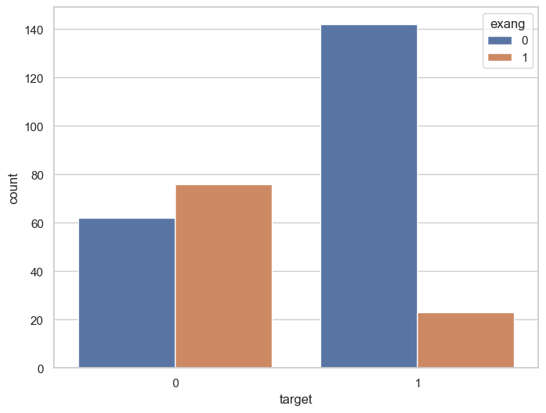
Showing Exang (exercise induced angina) attribute Distribution according to target attribute:
exang : exercise induced angina (1 = yes; 0 = no)
target : 1 or 0.( Value 0: stands for absence of heart disease)(Value 1: stands for presence of heart disease).
From the above plot of exang distribution according to target variable, our insights are that higher number of heart disease patients have no exang.

Slide 16
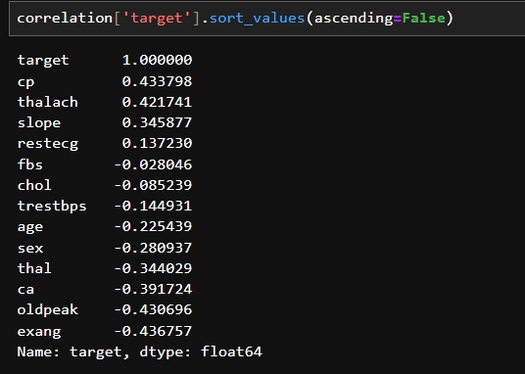
Bivariate Analysis:
Estimating Correlation Coefficient:
The target variable is 'target'. So, we should check how each attribute correlates with the 'target' variable. We can do it as follows:-
We can see that there is no strong positive or no strong negative correlation with ‘target’ variable.
There is no correlation
between ‘target’ and ‘fbs’
variable.
We can see that the ‘cp’ and
‘thalach’ variables are mildly
positively correlated with
‘target’ variable.

Slide 17
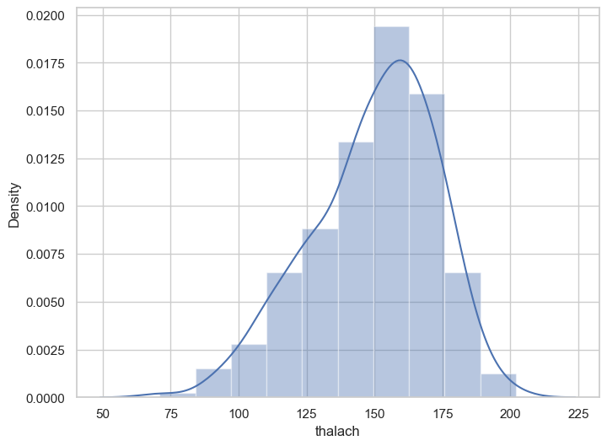
Visualising the frequency distribution of ‘thalach’ attribute:
‘thalach’ : maximum heart rate achieved
From the distribution plot we observe, that ‘thalach’ variable is slightly negatively skewed.

Slide 18
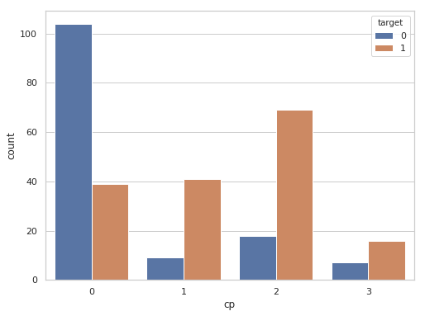
Visualizing the frequency distribution of target attribute with cp attribute :
Insights:
cp : chest pain type (4 values)
- Value 0: typical angina
- Value 1: atypical angina
- Value 2: non-anginal pain
- Value 3: asymptomatic
target : 1 or 0
- Value 0: absence of heart disease
- Value 1: presence of heart disease
From the plot we can observe that, for the patients with no heart disease are found to have chest pain of type 0 (i.e., typical angina).

Slide 19
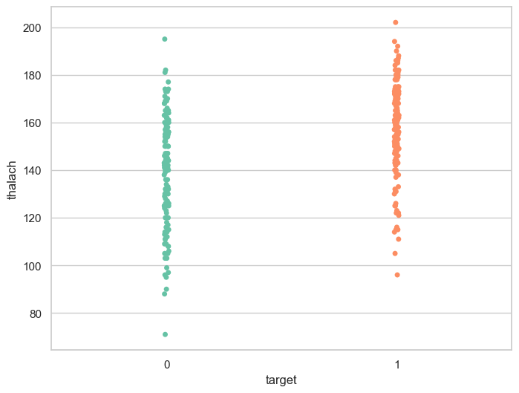
Visualizing the frequency distribution of target attribute with thalach attribute :
Insights:
thalach : maximum heart rate achieved
target : 1 or 0
- Value 0: absence of heart disease
- Value 1: presence of heart disease
The stripplot here confirms our finding
that people suffering from heart disease
(target = 1) have relatively higher heart
rate (thalach) as compared to people
who are not suffering from heart disease (target = 0).

Slide 20
Insights/Findings of Bivariate Analysis:
There is no variable which has strong positive correlation with 'target' variable.
There is no variable which has strong negative correlation with 'target' variable.
There is no correlation between 'target' and 'fbs’.
The 'cp' and 'thalach' variables are mildly positively correlated with 'target' variable.
We can see that the 'thalach' variable is slightly negatively skewed.
The people suffering from heart disease (target = 1) have relatively higher heart rate (thalach) as compared to people who are not suffering from heart disease (target = 0).

Slide 21
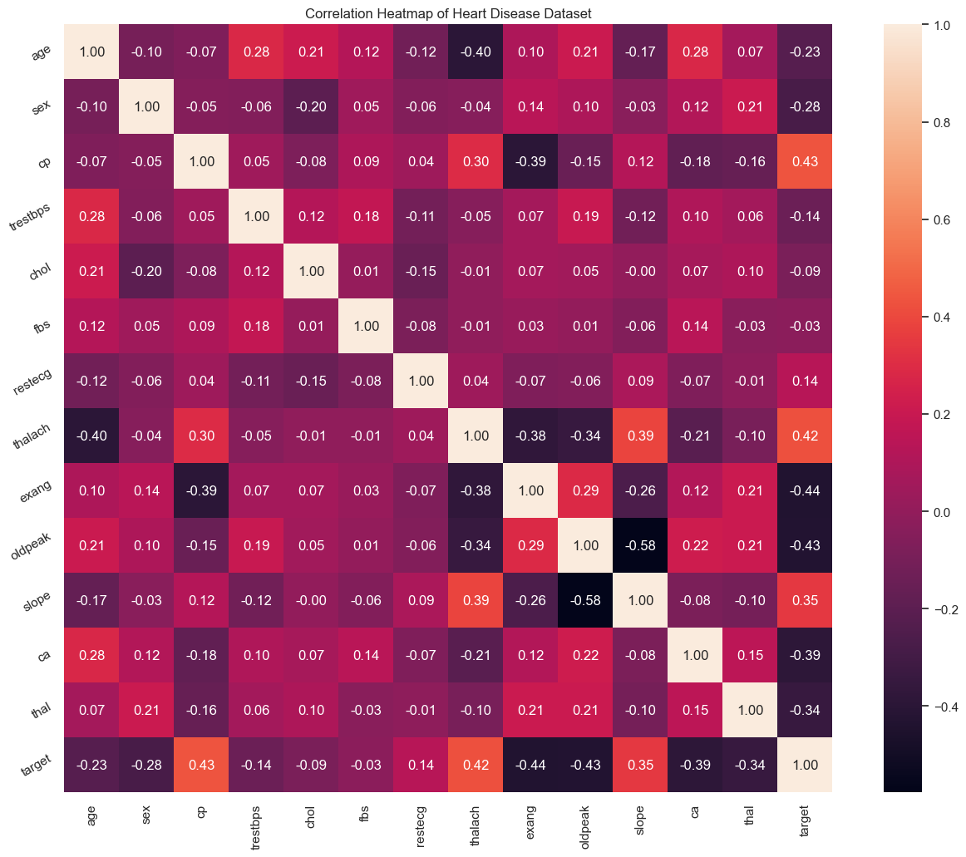
Multivariate Analysis:
The objective of the multivariate analysis is to discover patterns and relationships in the dataset. Below is the correlation heat map:

Slide 22
Multivariate Analysis:
Insights:
From the correlation heat map, we can conclude that :--
'target' and 'cp' variable are mildly positively correlated (correlation coefficient = 0.43).
'target' and 'thalach' variable are also mildly positively correlated (correlation coefficient = 0.42).
'target' and 'slope' variable are weakly positively correlated (correlation coefficient = 0.35).
'target' and 'exang' variable are mildly negatively correlated (correlation coefficient = -0.44).
'target' and 'oldpeak' variable are also mildly negatively correlated (correlation coefficient = -0.43).
'target' and 'ca' variable are weakly negatively correlated (correlation coefficient = -0.39).
'target' and 'thal' variable are also weakly negatively correlated (correlation coefficient = -0.34).

Slide 23
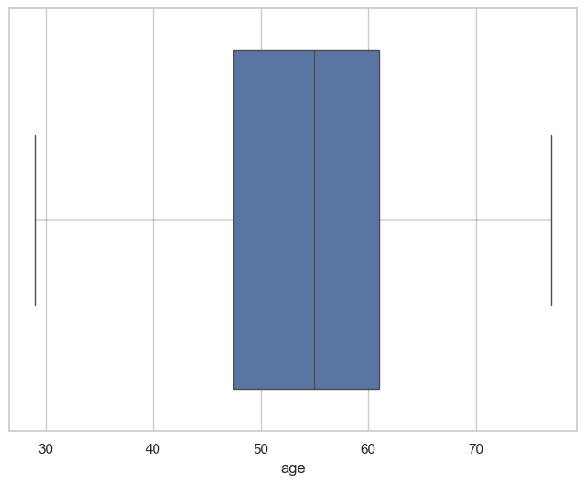
Outlier detection using ‘age’ attribute:
The 'age' variable does not contain any outlier.

Slide 24
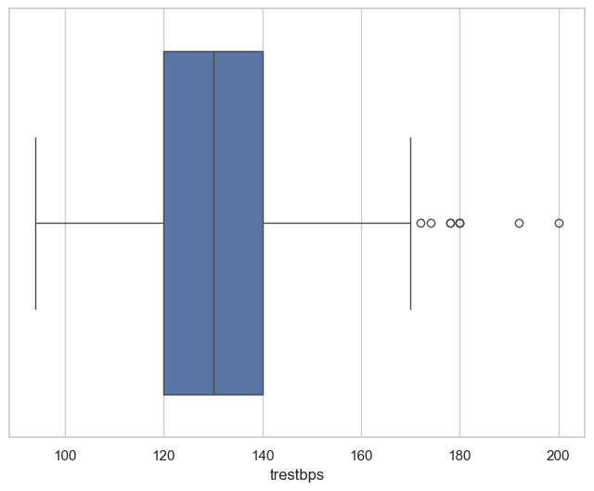
Outlier detection of ‘trestbps’ attribute:
'trestbps' variable contains outliers to the right side.

Slide 25
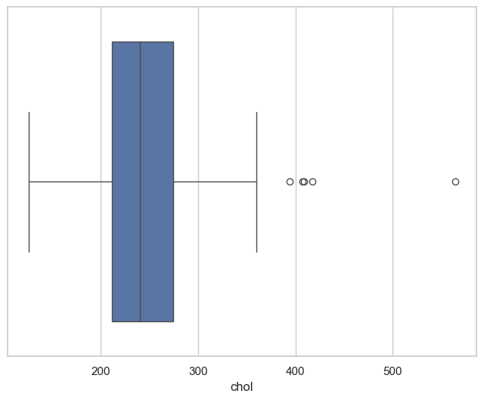
Outlier detection using ‘chol’ attribute:
'chol’ attribute also contains outliers to the right side.

Slide 26
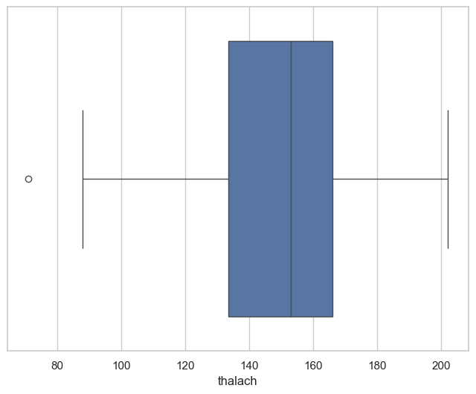
Outlier detection using ‘thalach’ attribute:
'thalach’ attribute contains a single outlier to the left side.

Slide 27
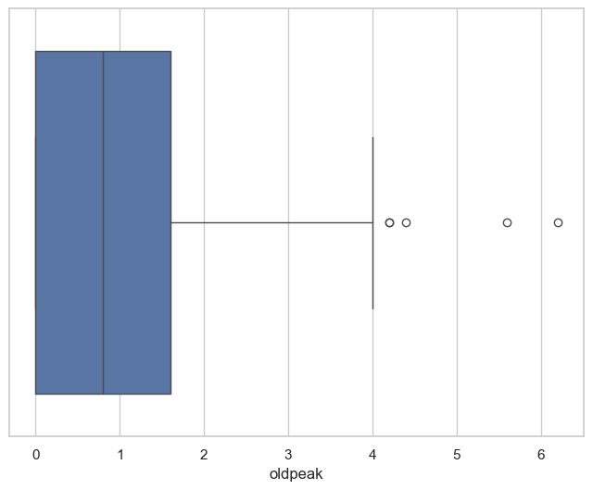
Outlier detection using ‘oldpeak’ attribute:
'oldpeak’ attribute contains outliers to the right side.

Slide 28
Conclusion:
In this kernel, we have explored the heart disease dataset.
We have implemented many of the strategies.
The feature variable of interest is `target` variable.
We have analyzed it alone and check its interaction with other variables.
We have also discussed how to detect missing data and outliers.

Slide 29
THANK YOU

